Slide 1
Integrity Constraints in DBMS

Slide 2
Integrity Constraints in DBMS
Integrity constraints in Database Management Systems (DBMS) are a set of rules that are applied on the table columns or relationships to ensure that the overall validity, integrity, and consistency (i.e. the quality) of the data present in the database table is maintained.
Each and every time a table insert, update, delete, or alter operation is performed, it is evaluated against the terms or rules mentioned in the integrity constraint
The data is inserted, updated, deleted, or altered only if the result of the constraint comes out to be True..

Slide 3
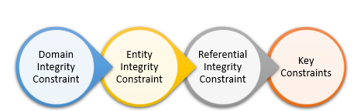
Types of Integrity Constraints
In relational DBMS, we primarily have four types of integrity constraints, namely :

Slide 4
1. Domain Integrity Constraint
Domain constraints can be defined as the definition of a valid set of values for an attribute.
The data type of domain includes string, character, integer, time, date, currency, etc. The value of the attribute must be available in the corresponding domain.

Slide 5
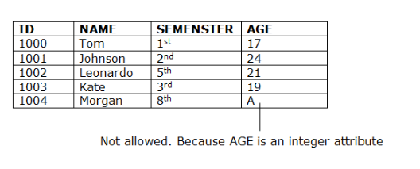
Example

Slide 6
2. Entity integrity constraints
Entity Integrity Constraints states that the primary value key cannot be null because the primary value key is used to find out individual rows in relation and if the value of the primary key is null then it is not easy to identify those rows.
There can be a null value in the table apart from the primary key field.

Slide 7
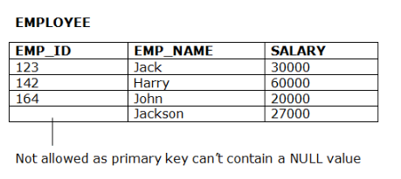
Example

Slide 8
3. Referential Integrity Constraints
A referential integrity constraint is specified between two tables.
In the Referential integrity constraints, if a foreign key in Table 1 refers to the Primary Key of Table 2, then every value of the Foreign Key in Table 1 must be null or be available in Table 2.

Slide 9
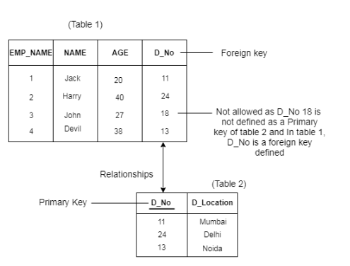
Example

Slide 10
4. Key constraints
Keys are the entity set that is used to identify an entity within its entity set uniquely.
An entity set can have multiple keys, but out of which one key will be the primary key. A primary key can contain a unique and null value in the relational table.

Slide 11
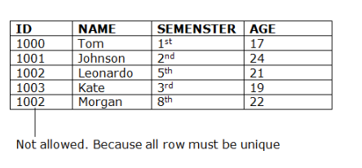
Example

